Slide 1
Introduction to Django Framework
Speaker : Harshil Mistry (D24CS112)
Convener :
Dr. Amit Thakkar
Head, CSE, CSPIT
Coordinators:
Dr. Jigar Sarda
Prof. Vaibhavi Patel

Slide 2
What exactly is Django?
Django is a high-level Python web framework. It helps one achieve rapid development and clean design. One gets benefits from batteries-included features, security, and scalability. Ideal for Python developers aiming for efficient web app creation.

Slide 3
Why Django over its alternatives?
1. Batteries included : Built-in tools such as authentication, database management, administrator interface, etc. 2. Highly Secure : Protection against SQL Injection, XSS, CSRF 3. Scalable & High Performance 4. Large community

Slide 4
Django: MVT Architectural Pattern
Django adopts the Model-View-Template (MVT) architecture. Models manage data interaction. Views process requests and manage responses and data flow. Templates handle presentation. Think of MTV as Django's unique take on the classic MVC pattern.
Model
Data layer, interacts with the database
View
User Interface, deals with requests and responses
Template
Presentation layer, defines how the data is displayed to the user

Slide 5
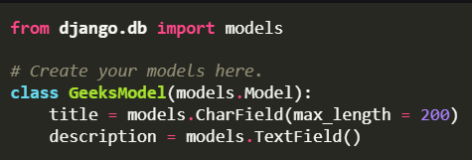
Django Models
A Django model is the built-in feature that Django uses to create tables, their fields, and various constraints. In short, Django Models is the SQL Database one uses with Django.

Slide 6
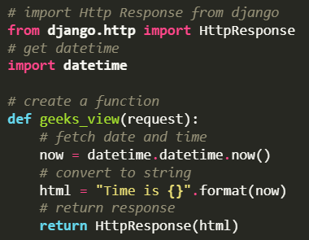
Django Views
A view function is a Python function that takes a Web request and returns a Web response.
This response can be the HTML contents of a Web page, a redirect, a 404 error, an XML document, an image, or anything that a web browser can display.

Slide 7
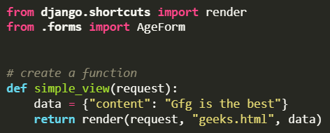
Django Templates
A template in Django is basically written in HTML, CSS, and Javascript in a .html file. Django framework efficiently handles and generates dynamic HTML web pages that are visible to the end-user.

Slide 8

Django File/Folder Structure
Django makes use of a directory structure to arrange different parts of the web application. It creates a project and an app folder for this.
Creating a proper project and organizing it helps in keeping the project DRY (Don’t Repeat Yourself) and clean.

Slide 9
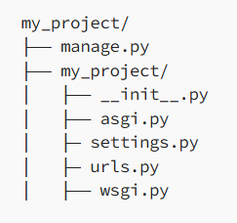

Creating Django Project
Command :

Slide 10

Project Files
manage.py : This small but mighty script serves as the gateway to various Django management commands. It’s the tool through which you initiate the development server, create applications, run migrations, and more.
settings.py : This file houses the settings that configure your Django project. From database configurations to middleware lists, this is where you define how your application functions.
urls.py : This file determines which view is displayed when a specific URL is accessed. It's like a roadmap that navigates users through the intricacies of your application's pages.

Slide 11
Project Files
wsgi.py: Short for Web Server Gateway Interface. It's the bridge connecting your application to the web server, enabling it to handle incoming requests.
asgi.py: Similar to wsgi.py, this is the entry point for asynchronous web servers. It stands for Asynchronous Server Gateway Interface and facilitates the handling of asynchronous HTTP requests.
__init__.py: This holds the magic that transforms a directory into a Python package. It’s essential for organizing and importing modules across your project

Slide 12
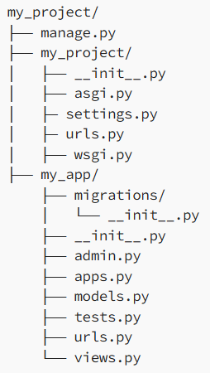

Creating Django Application
Command :

Slide 13
Application Files
models.py : This is where you define the data structures using Django's ORM (Object-Relational Mapping). Each model class represents a table in the database.
views.py : This file encapsulates the logic that defines how your application interacts with users' requests. Views handle data processing, rendering templates, and responding to actions.
tests.py : Test-driven development gains momentum through this file. Here, you write unit tests to ensure your application's components function as expected. These tests checks the reliability and stability of your codebase.

Slide 14
Application Files
admin.py : This file isn't just for administrators—it configures how your application's models are presented in Django's admin interface. This file allows administrators to manage data seamlessly.
migrations : This directory is a blueprint of all changes in your application models.
Other Files : Additional files might surface based on your application’s needs. For instance, forms.py houses form classes for data input, urls.py maps URLs to views, and apps.py manages application-specific configurations.

Slide 15
Let's Code !!
Github Repo Link :
https://github.com/harshil-mistry/django-seminar

Slide 16
Thankyou !!

